Slide 1
Data Structures and Algorithms
LECTURE 05: ALGORITHM ANALYSIS

Slide 2
Algorithmic Performance
There are two aspects of algorithmic performance:
Time
Instructions take time.
How fast does the algorithm perform?
What affects its runtime?
Space
Data structures take space
What kind of data structures can be used?
How does choice of data structure affect the runtime?
We will focus on time:
How to estimate the time required for an algorithm
How to reduce the time required

Slide 3
Analysis of Algorithms
How do we compare the time efficiency of two algorithms that solve the same problem: implement these algorithms in a programming language (C++), and run them to compare their time requirement
How are the algorithms coded?
Comparing running times means comparing the implementations.
We should not compare implementations, because they are sensitive to programming style that may cloud the issue of which algorithm is inherently more efficient.
What computer should we use?
We should compare the efficiency of the algorithms independently of a particular computer.
What data should the program use?
Any analysis must be independent of specific data.

Slide 4
Analysis of Algorithms
When we analyze algorithms, we should employ mathematical techniques that analyze algorithms independently of specific implementations, computers, or data.
To analyze algorithms:
First, we start to count the number of significant operations in a particular solution to assess its efficiency.
Then, we will express the efficiency of algorithms using growth functions.

Slide 5
The Execution Time of Algorithms
Each operation in an algorithm (or a program) has a cost.
➔ Each operation takes a certain of time.
count = count + 1; ➔ take a certain amount of time, but it is constant
A sequence of operations:
count = count + 1; Cost: c₁
sum = sum + count; Cost: c₂
➔ Total Cost = c₁ + c₂

Slide 6
The Execution Time of Algorithms (cont.)
Example: Simple If-Statement
Cost Times
if (n < 0) c1 1
absval = -n c2 1
else
absval = n; c3 1
Total Cost <= c1 + max(c2,c3)

Slide 7
The Execution Time of Algorithms (cont.)
Example: Simple Loop
Cost Times
i = 1; c1 1
sum = 0; c2 1
while (i <= n) { c3 n+1
i = i + 1; c4 n
sum = sum + i; c5 n
}
Total Cost = c1 + c2 + (n+1)*c3 + n*c4 + n*c5
➔ The time required for this algorithm is proportional to n

Slide 8
The Execution Time of Algorithms (cont.)
Example: Nested Loop
Cost Times
i=1; c1 1
sum = 0; c2 1
while (i <= n) { c3 n+1
j=1; c4 n
while (j <= n) { c5 n*(n+1)
sum = sum + i; c6 n*n
j = j + 1; c7 n*n
}
i = i +1; c8 n
}
Total Cost = c1 + c2 + (n+1)*c3 + n*c4 + n*(n+1)*c5+n*n*c6+n*n*c7+n*c8
➔ The time required for this algorithm is proportional to n²

Slide 9
General Rules for Estimation
Loops: The running time of a loop is at most the running time of the statements inside of that loop times the number of iterations.
Nested Loops: Running time of a nested loop containing a statement in the inner most loop is the running time of statement multiplied by the product of the sized of all loops.
Consecutive Statements: Just add the running times of those consecutive statements.
If/Else: Never more than the running time of the test plus the larger of running times of S1 and S2.

Slide 10
Algorithm Growth Rates
We measure an algorithm’s time requirement as a function of the problem size.
Problem size depends on the application: e.g. number of elements in a list for a sorting algorithm, the number disks for towers of hanoi.
So, for instance, we say that (if the problem size is n)
Algorithm A requires 5*n² time units to solve a problem of size n.
Algorithm B requires 7*n time units to solve a problem of size n.
The most important thing to learn is how quickly the algorithm’s time requirement grows as a function of the problem size.
Algorithm A requires time proportional to n².
Algorithm B requires time proportional to n.
An algorithm’s proportional time requirement is known as growth rate.
We can compare the efficiency of two algorithms by comparing their growth rates.

Slide 11
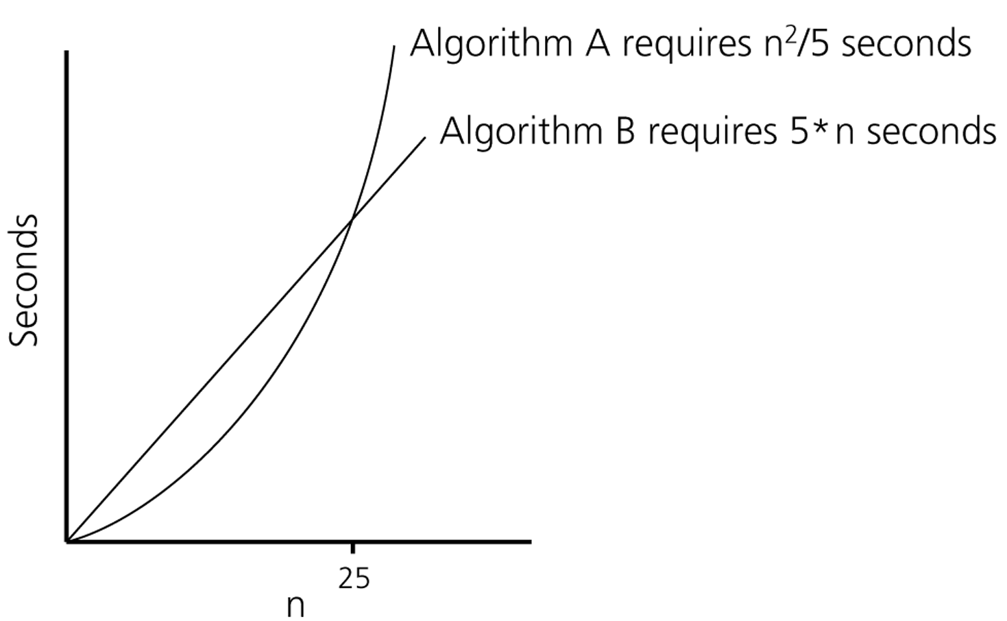
Algorithm Growth Rates (cont.)
Time requirements as a function
of the problem size n

Slide 12
Common Growth Rates
Function | Growth Rate Name
c | Constant
log N | Logarithmic
log²N | Log-squared
N | Linear
N log N
N² | Quadratic
N³ | Cubic
2^{N} | Exponential

Slide 13
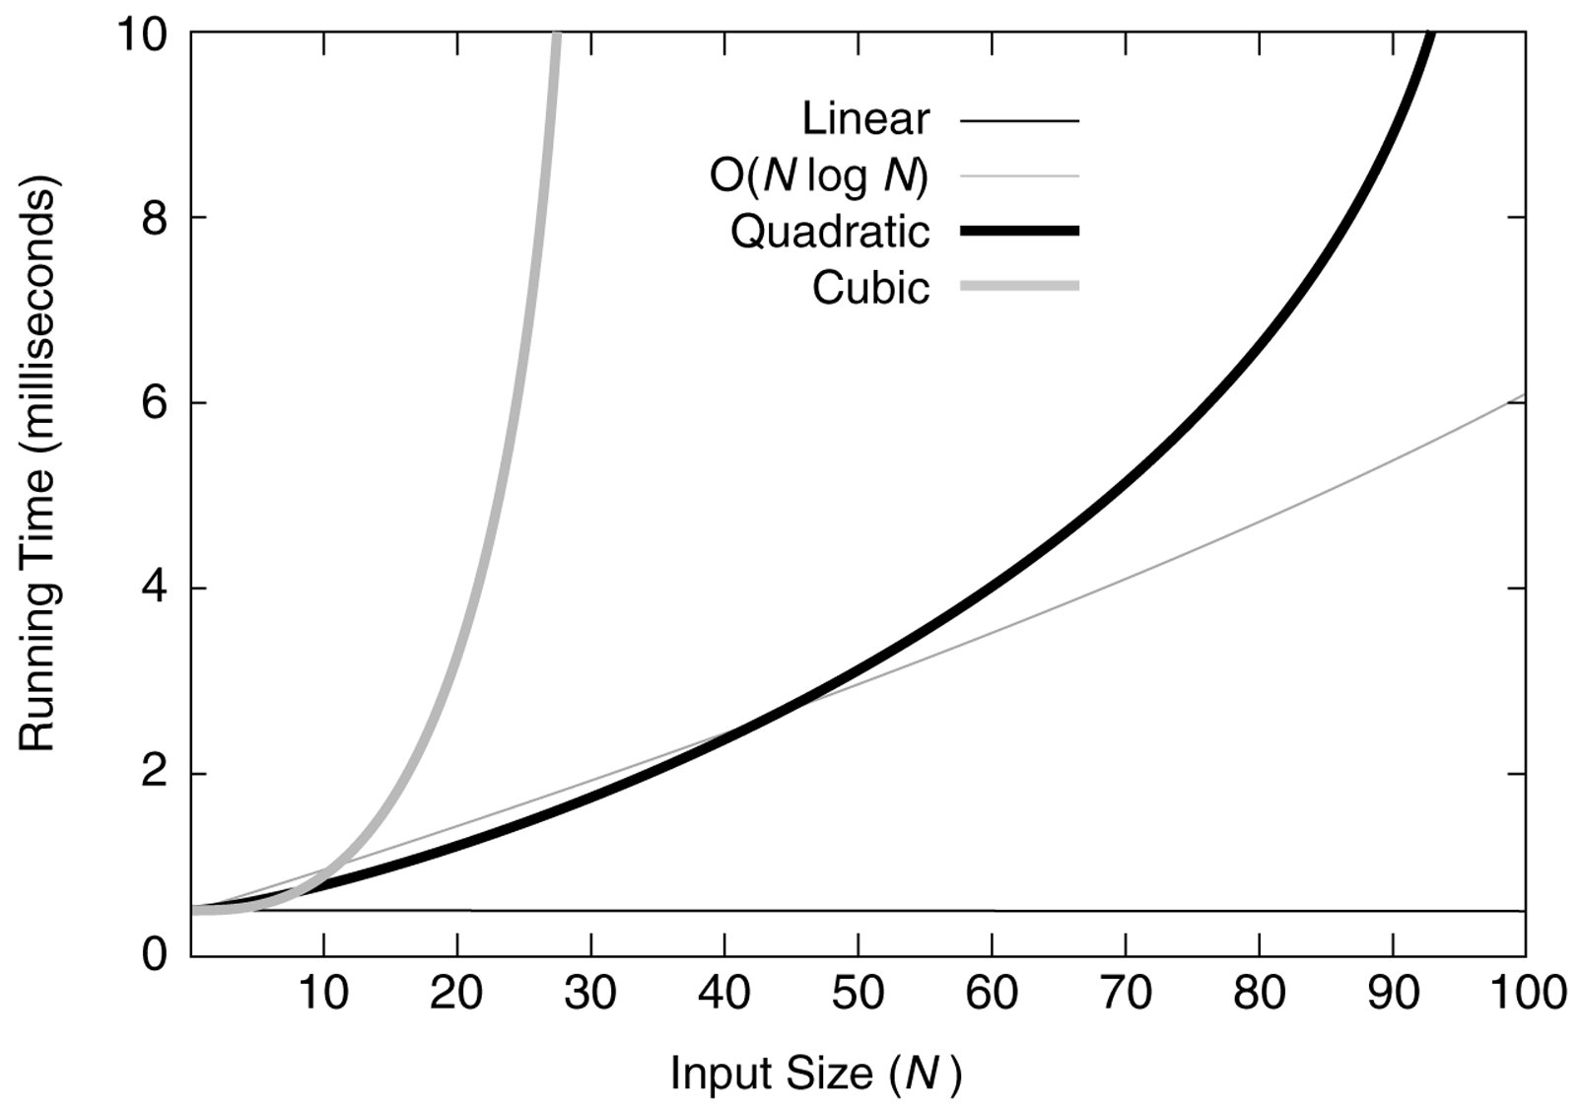
Common Growth Rates

Slide 14
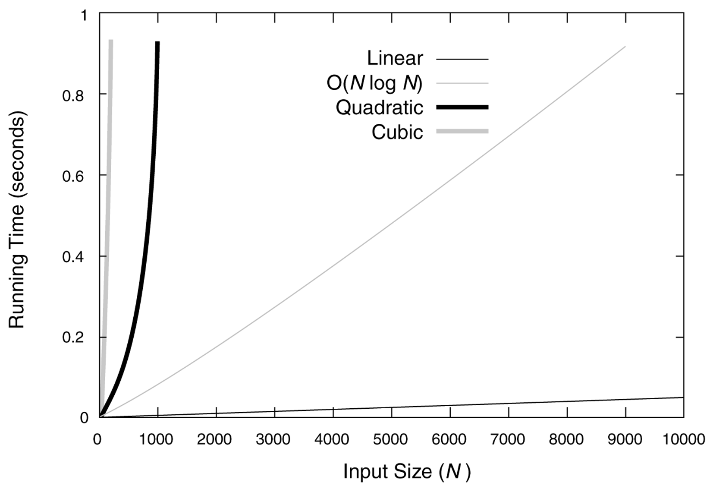
Common Growth Rates

Slide 15
Order-of-Magnitude Analysis and Big O Notation
If Algorithm A requires time proportional to f(n), Algorithm A is said to be order f(n), and it is denoted as O(f(n)).
The function f(n) is called the algorithm’s growth-rate function.
Since the capital O is used in the notation, this notation is called the Big O notation.
If Algorithm A requires time proportional to n², it is O(n²).
If Algorithm A requires time proportional to n, it is O(n).

Slide 16
Definition of the Order of an Algorithm
Definition:
Algorithm A is order f(n) – denoted as O(f(n)) –
if constants k and n₀ exist such that A requires
no more than k*f(n) time units to solve a problem
of size n ≥ n₀.
The requirement of n ≥ n₀ in the definition of O(f(n)) formalizes the notion of sufficiently large problems.
In general, many values of k and n can satisfy this definition.

Slide 17
Order of an Algorithm
If an algorithm requires n²–3*n+10 seconds to solve a problem size n. If constants k and n₀ exist such that
k*n² > n²–3*n+10 for all n ≥ n₀ .
the algorithm is order n² (In fact, k is 3 and n₀ is 2)
3*n² > n²–3*n+10 for all n ≥ 2 .
Thus, the algorithm requires no more than k*n² time units for n ≥ n₀ ,
So it is O(n²)

Slide 18
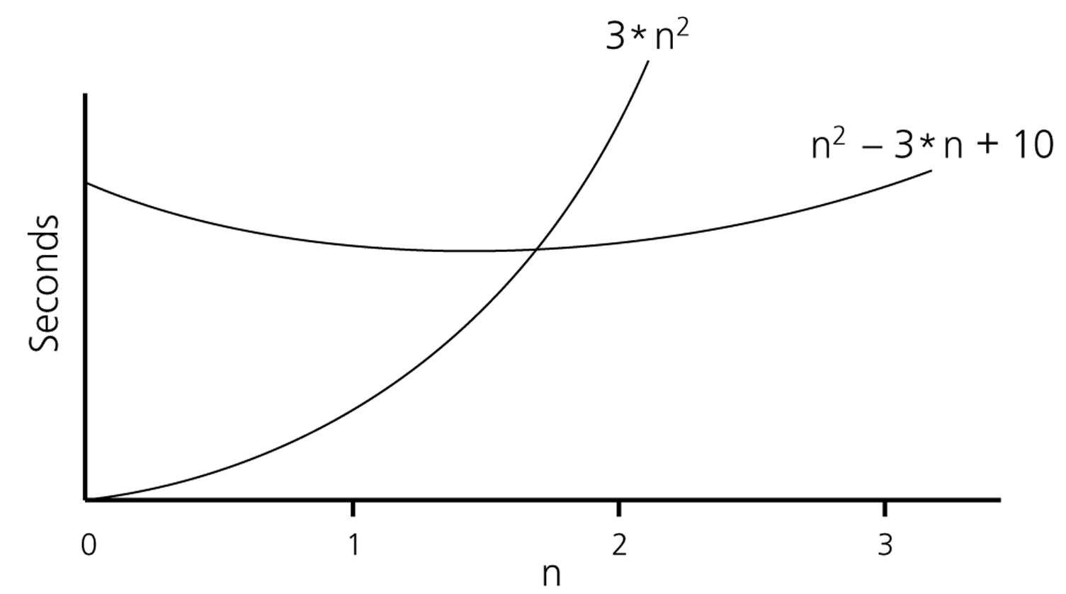
Order of an Algorithm (cont.)

Slide 19
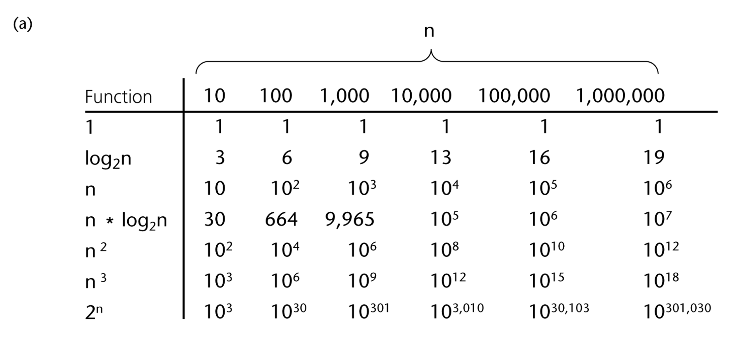
A Comparison of Growth-Rate Functions

Slide 20
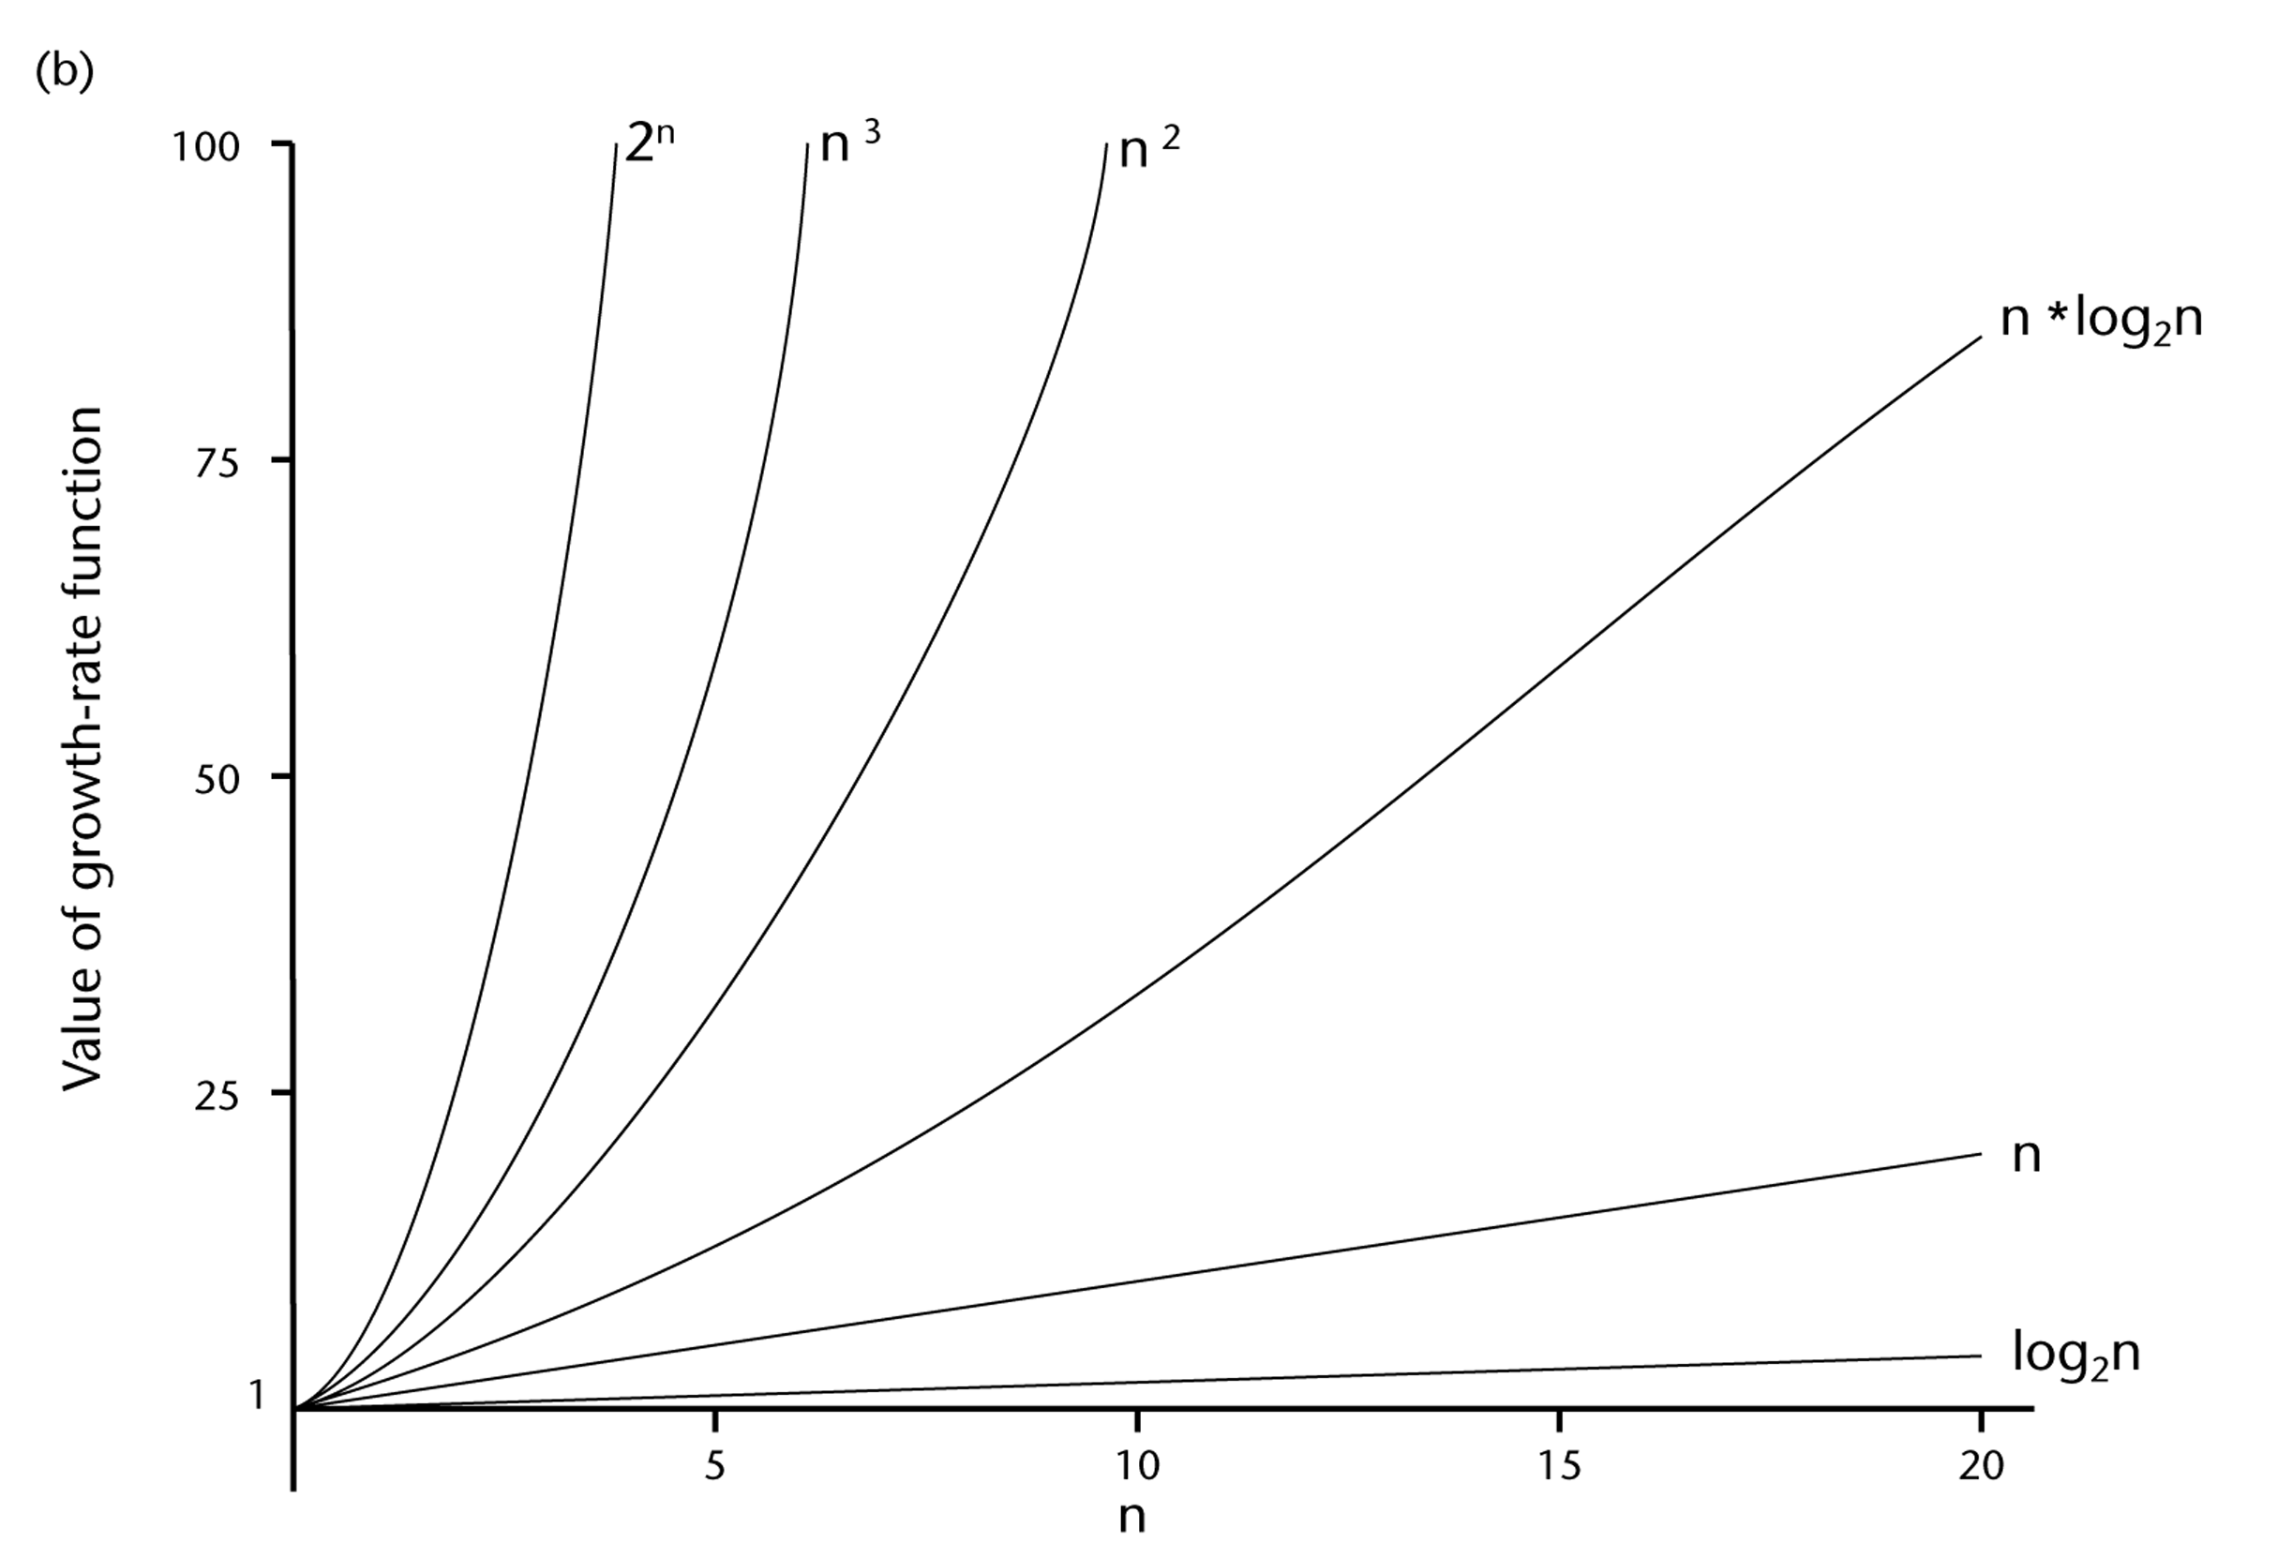
A Comparison of Growth-Rate Functions (cont.)

Slide 21
Growth-Rate Functions
O(1) Time requirement is constant, and it is independent of the problem’s size.
O(log₂n) Time requirement for a logarithmic algorithm increases increases slowly
as the problem size increases.
O(n) Time requirement for a linear algorithm increases directly with the size
of the problem.
O(n*log₂n) Time requirement for a n*log₂n algorithm increases more rapidly than
a linear algorithm.
O(n²) Time requirement for a quadratic algorithm increases rapidly with the
size of the problem.
O(n³) Time requirement for a cubic algorithm increases more rapidly with the
size of the problem than the time requirement for a quadratic algorithm.
O(2^{n}) As the size of the problem increases, the time requirement for an
exponential algorithm increases too rapidly to be practical.

Slide 22
Growth-Rate Functions
If an algorithm takes 1 second to run with the problem size 8, what is the time requirement (approximately) for that algorithm with the problem size 16?
If its order is:
O(1) ➔ T(n) = 1 second
O(log₂n) ➔ T(n) = (1*log₂16) / log₂8 = 4/3 seconds
O(n) ➔ T(n) = (1*16) / 8 = 2 seconds
O(n*log₂n) ➔ T(n) = (1*16*log₂16) / 8*log₂8 = 8/3 seconds
O(n²) ➔ T(n) = (1*16²) / 8² = 4 seconds
O(n³) ➔ T(n) = (1*16³) / 8³ = 8 seconds
O(2^{n}) ➔ T(n) = (1*2¹⁶) / 2⁸ = 2⁸ seconds = 256 seconds

Slide 23
Properties of Growth-Rate Functions
We can ignore low-order terms in an algorithm’s growth-rate function.
If an algorithm is O(n³+4n²+3n), it is also O(n³).
We only use the higher-order term as algorithm’s growth-rate function.
We can ignore a multiplicative constant in the higher-order term of an algorithm’s growth-rate function.
If an algorithm is O(5n³), it is also O(n³).
O(f(n)) + O(g(n)) = O(f(n)+g(n))
We can combine growth-rate functions.
If an algorithm is O(n³) + O(4n), it is also O(n³ +4n²) ➔ So, it is O(n³).
Similar rules hold for multiplication.

Slide 24
Some Mathematical Facts
Some mathematical equalities are:

Slide 25
Growth-Rate Functions – Example1
Cost Times
i = 1; c1 1
sum = 0; c2 1
while (i <= n) { c3 n+1
i = i + 1; c4 n
sum = sum + i; c5 n
}
T(n) = c1 + c2 + (n+1)*c3 + n*c4 + n*c5
= (c3+c4+c5)*n + (c1+c2+c3)
= a*n + b
➔ So, the growth-rate function for this algorithm is O(n)

Slide 26
Growth-Rate Functions – Example2
Cost Times
i=1; c1 1
sum = 0; c2 1
while (i <= n) { c3 n+1
j=1; c4 n
while (j <= n) { c5 n*(n+1)
sum = sum + i; c6 n*n
j = j + 1; c7 n*n
}
i = i +1; c8 n
}
T(n) = c1 + c2 + (n+1)*c3 + n*c4 + n*(n+1)*c5+n*n*c6+n*n*c7+n*c8
= (c5+c6+c7)*n² + (c3+c4+c5+c8)*n + (c1+c2+c3)
= a*n² + b*n + c
➔ So, the growth-rate function for this algorithm is O(n²)

Slide 27
The end

